Slide 1


DATA ANALYST PORT FOLIO PROJECT
POWER BI + MY SQL
BY MOHAMMED RAMEEZ RAJA
Start to end

Slide 2
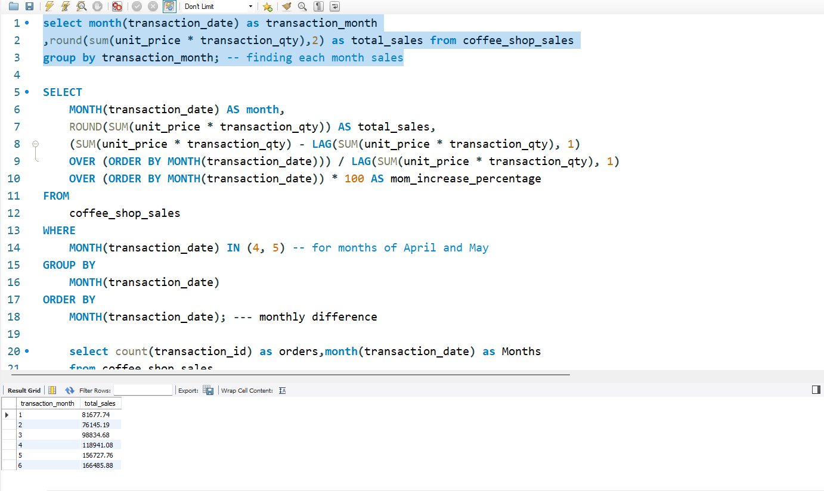

MY SQL
EXECUTING SQL QUERIES TO ADDRESS BUSINESS CHALLENGES.

Slide 3
WHAT ARE THE STEPS THAT I HAVE DONE IN MYSQL
MY SQL
→Data walkthrough →raw data file preparation →Creating Database →importing file →cleaning imported file →changing data types →Executing SQL queries to address business challenges. →storing results →preparing sql Documents

Slide 4
FUNCTIONS THAT I USED IN THIS PROJECT
STR_TO_DATE
ROUND
SUM
COUNT
AVG
LAG
MONTH
DAY
DAYOFWEEK
SELECT
ALIAS
MAX/MIN
→ HOUR → ALTER TABLE → UPDATE TABLE → CHANGE COLUMN → WHERE → GROUP BY → CASE → ORDER BY → LIMIT → WINDOW FUNCTIONS → JOINS → SUBQUERIES

Slide 5
PROBLEM STATEMENTS
KPI'S REQUIREMENTS
1. Total Sales Analysis:
• Calculate the total sales for each respective month.
• Determine the month-on-month increase or decrease in sales.
• Calculate the difference in sales between the selected month and the previous month.
2. Total Orders Analysis:
• Calculate the total number of orders for each respective month.
• Determine the month-on-month increase or decrease in the number of orders.
• Calculate the difference in the number of orders between the selected month and the previous month. 3. Total Quantity Sold Analysis:
• Calculate the total quantity sold for each respective month.
• Determine the month-on-month increase or decrease in the total quantity sold.
• Calculate the difference in the total quantity sold between the selected month and the previous month.

Slide 6
PROBLEM STATEMENT
CHARTS REQUIREMENTS
1. Calendar Heat Map:
→Implement a calendar heat map that dynamically adjusts based on the selected month from a slicer.
→Each day on the calendar will be color-coded to represent sales volume, with darker shades indicating higher sales.
→Implement tooltips to display detailed metrics (Sales, Orders, Quantity) when hovering over a specific day.
2. Sales Analysis by Weekdays and Weekends:
→ Segment sales data into weekdays and weekends to analyse performance variations.
→ Provide insights into whether sales patterns differ significantly between weekdays and weekends.
3. Sales Analysis by Store Location:
→ Visualize sales data by different store locations.
→ Include month-over-month (MoM) difference metrics based on the selected month in the slicer.
→ Highlight MoM sales increase or decrease for each store location to identify trends.

Slide 7
PROBLEM STATEMENT
CHARTS REQUIREMENTS
4. Daily Sales Analysis with Average Line:
→Display daily sales for the selected month with a line chart.
→ Incorporate an average line on the chart to represent the average daily sales.
→ Highlight bars exceeding or falling below the average sales to identify exceptional sales days.
5. Sales Analysis by Product Category:
→ Analyse sales performance across different product categories.
→ Provide insights into which product categories contribute the most to overall sales.
6. Top 10 Products by Sales:
→ Identify and display the top 10 products based on sales volume.
→ Allow users to quickly visualize the best-performing products in terms of sales.
7. Sales Analysis by Days and Hours:
→ Utilize a heat map to visualize sales patterns by days and hours.
→ Implement tooltips to display detailed metrics (Sales, Orders, Quantity) when hovering over a specific day-hour.

Slide 8
